Slide 1
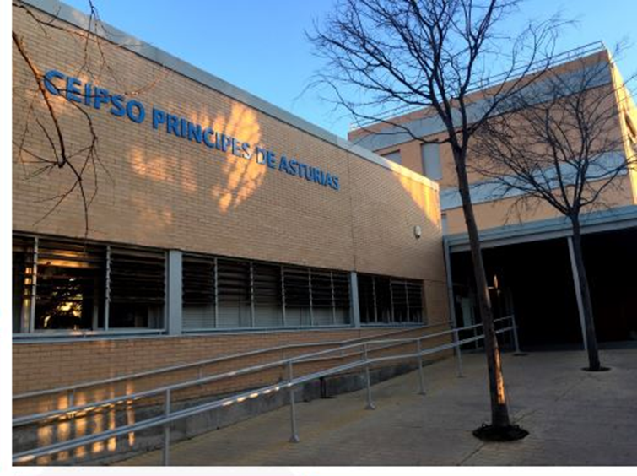
ACTIVITY DETAILS
ERASMUS PROJECT 2018-2021

Slide 2
PREPARATORY ACTIVITIES

Slide 3
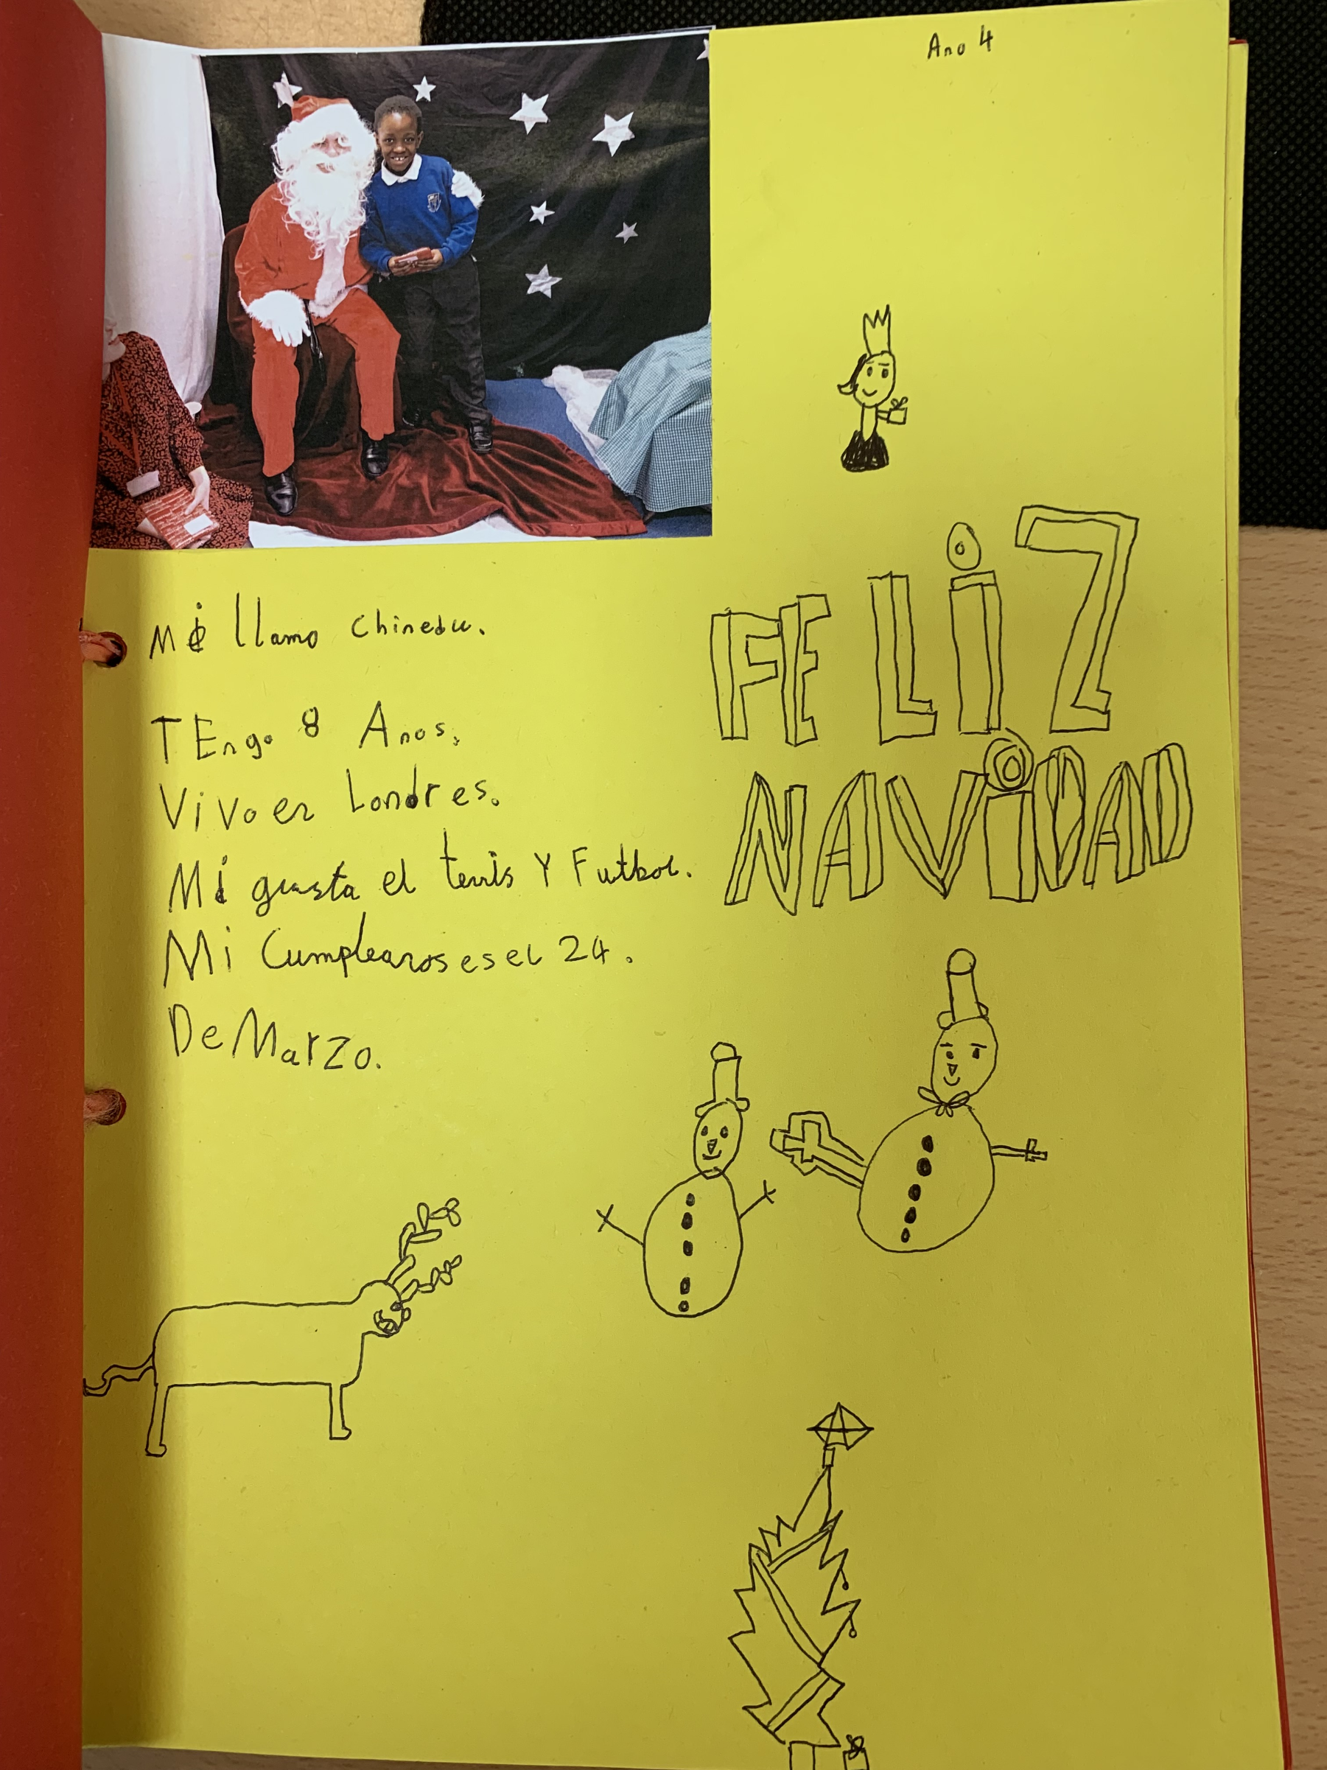
Exchange of work at Christmas 2018-2019
We wrote Christmas cards to exchange works with our partner school in Spain.
They also sent us cards to practise and improve their English.

Slide 4
Children from our partner school recorded some videos explaining their Christmas traditions and singing their most popular ‘Christmas Carols’.

Slide 5
WORKS DISPLAY

Slide 6
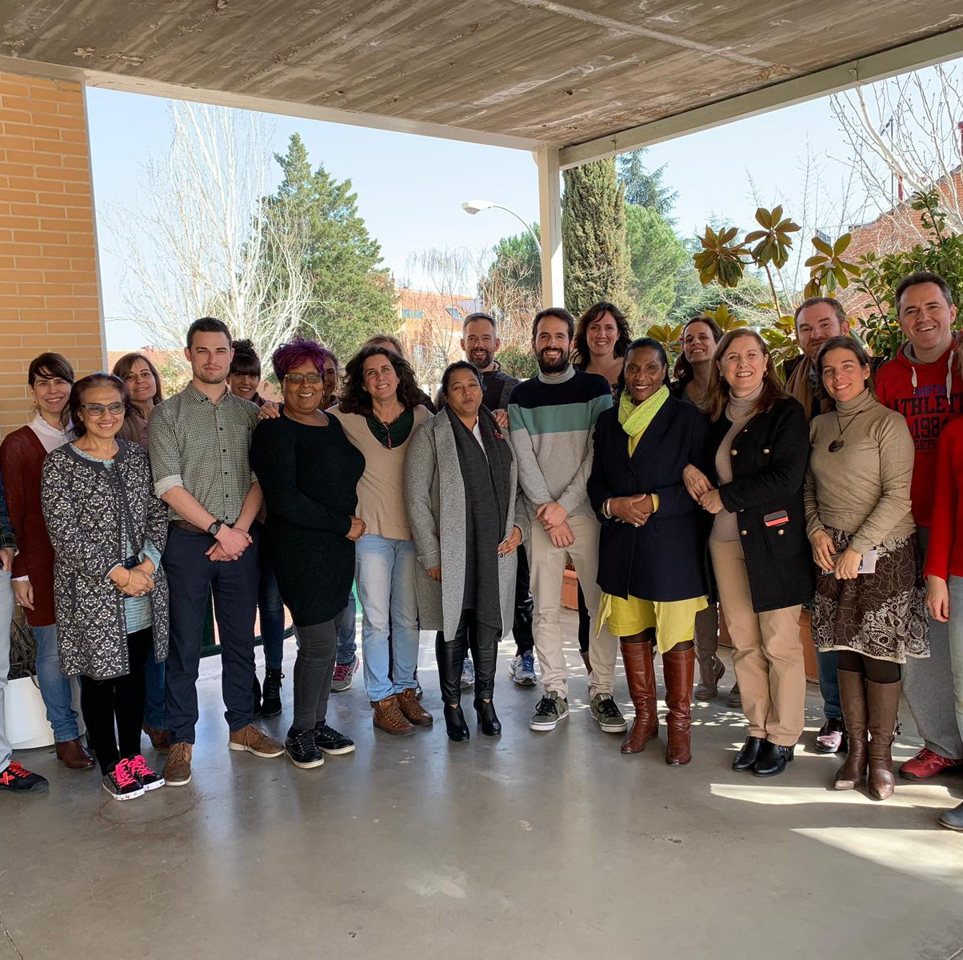
ACTIVITY 1 First teachers’ meeting in Spain
- Interested in how Special Needs pupils are supported, encouraged and taught in our school.
February 2019

Slide 7
Timetable for Teachers - 18th - 21st February 2019
 | MONDAY 18 |  | TUESDAY 19 |  |  |  | WEDNESDAY 20 |  |  |  |  | THURSDAY 21
9:00- 10:00 | Welcome School tour Inma + Paula |  | 5º B Social skills (Jesús) Paula |  |  | 3 y.o. B Assembly (9:00-9:30) Ana PT + Bea EI (Antonio) |  |  | Older * grouping Bea PT (secondarysts + Eire MELISSA |  | Older * grouping Bea PT (secondarysts + Eire) MELISSA |  |  | 3 y.o.B Assembly (9:00-9:30) Ángeles (Antonio) Inma
10:00-11:00 | Presentation Meeting Inma + Paula |  | 1º A * Language Rosa (Adrián) Ref.group |  | Infant Ed. TEA students Ana PT | Workshop: Bea PT Awareness about Autism 6º A+B (Jordyn + Cristina) SCHOOL LIBRARY |  |  |  |  | Entrepreneurship 5th A+B, Paula, Jesús SCHOOL LIBRARY |  |  | Older * grouping Bea PT (secondarysts + Eire) MELISSA
 |  |  |  |  | 10:55- 11:25 Secondary Workshop BEA PT *
11:00-11:45 11:30 →Inclusion * breakfast in Infant Ed. | TEA DEPT. Teacher’s Meeting Ana PT+ Bea PT |  | 1ºA * (Adrián) Ángeles+ Rosa |  |  | Entrepreneurship 5th A+B Pablo,Paula, Jesús SCHOOL LIBRARY |  |  |  |  | Entrepreneurship 5th A+B Pablo, Paula, Jesús SCHOOL LIBRARY
 | COFFEE BREAK |  | COFFEE BREAK |  |  | COFFEE BREAK |  |  |  |  | COFFEE BREAK
11:45-12:15 Playground Workshops | BREAK Ángeles * 1º EPO |  | BREAK Ana PT Infant Education |  |  | BREAK Ana TIS * 4º EPO |  |  |  |  | BREAK Social skills* 4º EPO Bea PT
12:15-13:15 | 3 y.o B ** (Antonio) Bea EI+ Ángeles (Mary) | 4th A Maths* (Eire) Bea PT+ Mercedes | Workshop: Bea PT Equal and Diffferent 5º A+B (Jesús, Paula) SCHOOL LIBRARY |  |  |  |  | PT Cristina AL Fran |  | 4th A (Eire)* Maths corners Mecedes |  |  | ARTS 4º A (Eire) Micaela | 4 y.o. Ana PT (Lucas)
13.15- 14:00 | P.E. 4ª Jesús (Eire) Ana TIS inclusion teacher | 1ºA ** (Adrián) Ángeles+Rosa (Mary) | Social skills 1º (Adrián) Ana PT TEA room | 4º A Gifted* 6th grade students Mercedes |  |  | Entrepreneurship 5th A+B, Begoña, Pablo, Jesús SCHOOL LIBRARY |  |  |  |  | 1ºA (Adrián) Ángeles, Maite, Begoña Sciences
14:00-15:00 | TEACHER´S MEETING ERASMUS PROJECT AFTER LUNCH ACTIVITIES IN MADRID |  | FREE AFTERNOON |  |  |  | FREE TOUR AND DINNER |  |  |  |  | Farewell!! Bye!

Slide 8
Creating Awareness Activities

Slide 9
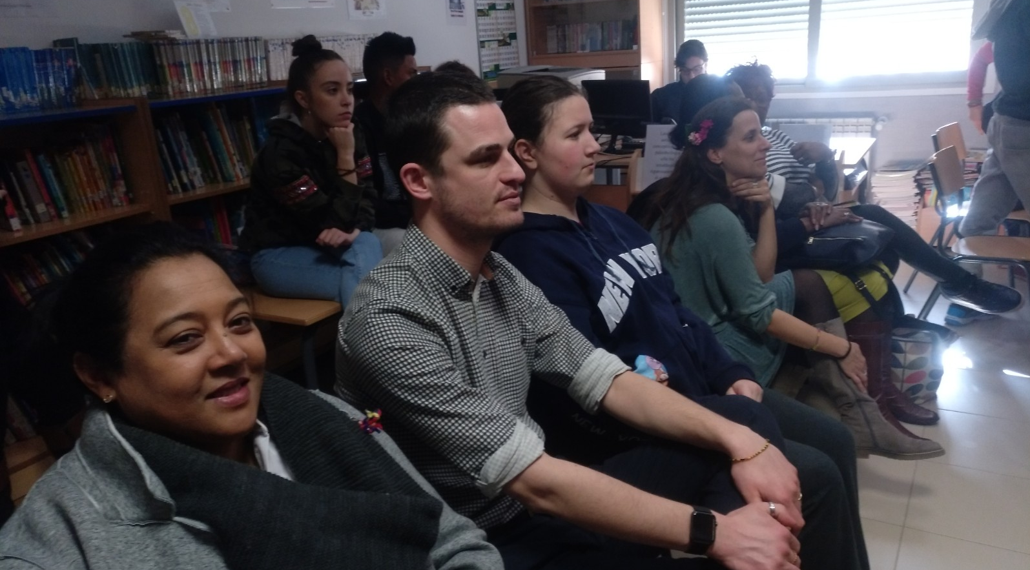
AUTISM TALK

Slide 10
English teachers introduce the WORK-WEEK in our school

Slide 11
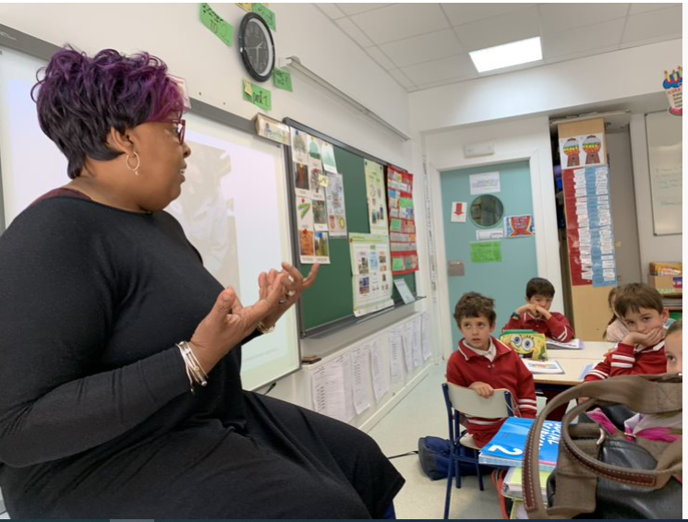
STORYTELLING, DEBATE, ETC

Slide 12
Teachers’ Team Building Activities: “Terraceo and Tapas", cultural free tour...

Slide 13
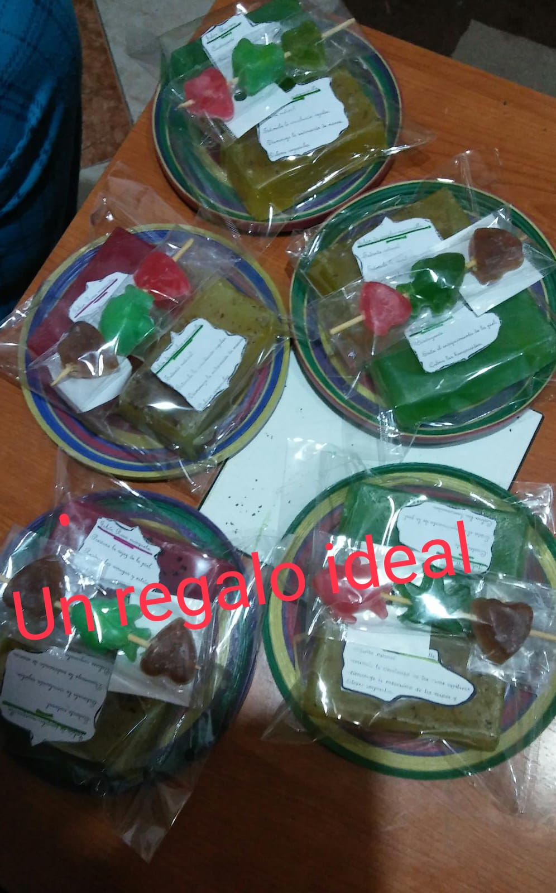
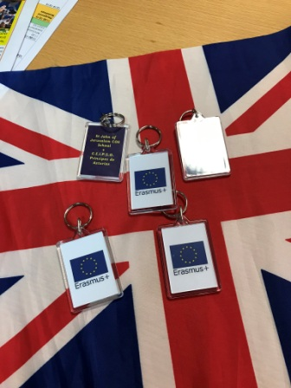
Feedback session
- assessing our visit
- organising our next meeting key points .

Slide 14
ACTIVITY 2 15 Spanish students from our partner school visit St John of Jerusalem July 2019

Slide 15
CONFERENCE:
Religions in the world
School Welcoming Assembly.

Slide 16
Making silhouettes: with the year 5 class to work on the professions
P.E. Class

Slide 17
SPORTS DAY:
with different games in which teachers, students and families participated.
Picnic with the school teachers

Slide 18
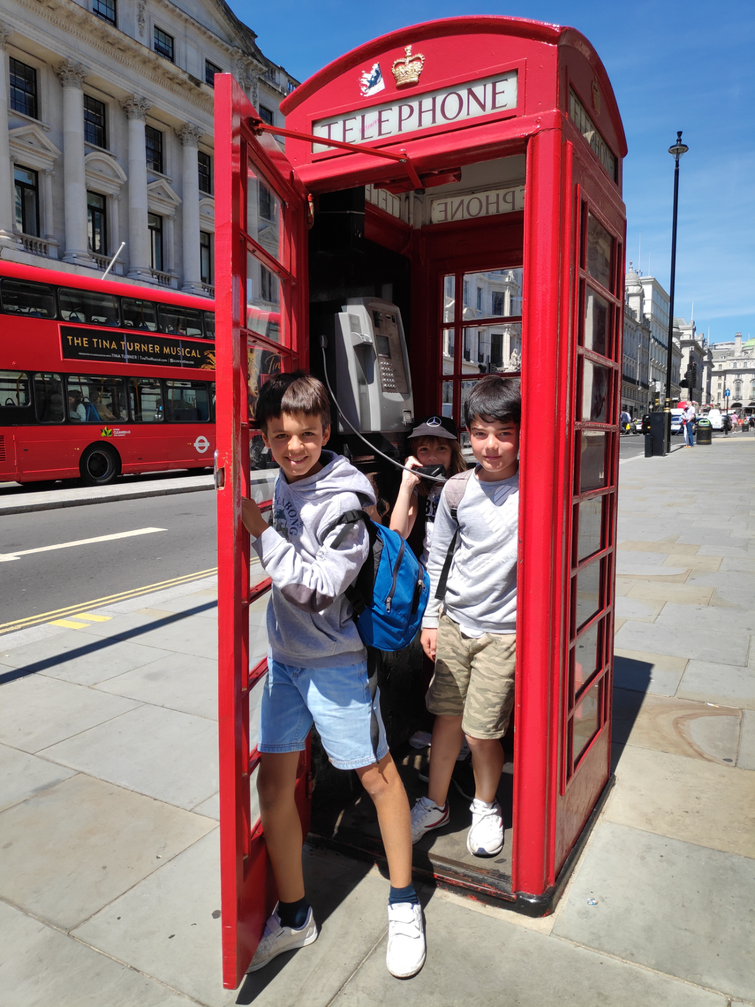
Getting around London: Visit to the Museum of London and walk to Picadilly Circus, Trafalgar Square, Hamleys toy store.

Slide 19
Feedback meeting and farewell

Slide 20
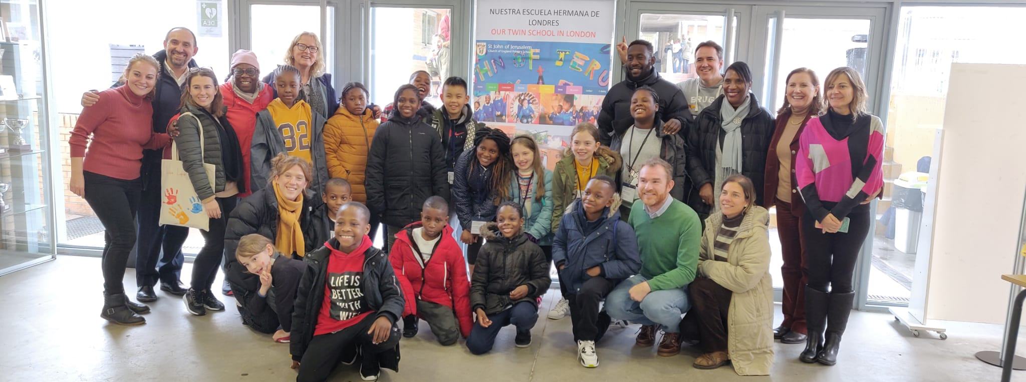
15 children and some teachers from St John of Jerusalem visit our partner School in Spain November 2019
ACTIVITY 3

Slide 21
 | MONDAY 18 | TUESDAY 19 | WEDNESDAY 20 | THURSDAY 21
9:00- 9:30 | 09:15 Welcome School tour Presentation | Work week activities a-1A b-5A c-4 years old | Work week activities a-4 years old b-2B c--5B | SPORTS DAY OUTDOOR ACTIVITIES COOPERATIVE GAMES Jesús Álvaro
9:30 -10:00 | Introduction in the class Work week activities 5A / 6A
10:00-11:00 | Work week Activities a- 2A b-6B c- 5B | Work week activities a-6A b-5B c-3B | Workshop: Bea PT Equal and Different (Amanda, Jordyn, Patricia) 5º A+B SCHOOL LIBRARY
11:00-11:45 11:30 →Inclusion * breakfast in Infant Ed. | Work week activities a-1B b- 5A c-4A | Work week activities a-3A b-4B c-6A | Work week activities a-1B b-6B c- 5A
 | COFFEE BREAK | COFFEE BREAK | COFFEE BREAK | COFFEE BREAK
11:45-12:15 Playground Workshops + volunteers | BREAK Ángeles * 1º EPO (TEAM a) | BREAK Ana PT Infant Education (TEAM b) | BREAK Ana TIS * 5º EPO (TEAM c) | BREAK Social skills* 5th + 6th Bea PT (TEAMS a,b,c)
12:15-13:15 | Work week activities a -6A b- 4A c- P.E. 2B | Workshop: Bea PT Awareness about Autism 6º A+B (Jordyn, Paula, Inma, Jorge) SCHOOL LIBRARY | Spanish lessons * a-6A b-1B c-2A | Work week activities (FEEDBACK) 5B 6B
13.15- 14:00 | Work week activities a - 5B b -2A c –6B | Spanish lessons * a-2A b-1A c-5B | Infant Education * a-3 years old b-5 years old A c-5 years old B | Final Assessment 5A 6A
14:00-15:00 | STUDENT´S LUNCH AT SCHOOL
14:00-15:00 | TEACHER´S MEETING ERASMUS PROJECT AFTER LUNCH FREE AFTERNOON | Sightseeing Bus in the afternoon | TEACHER´S MEETING ERASMUS PROJECT Museum | Thanksgiving Farewell!!
18TH TO 21ST NOVEMBER 2019
Timetable

Slide 22
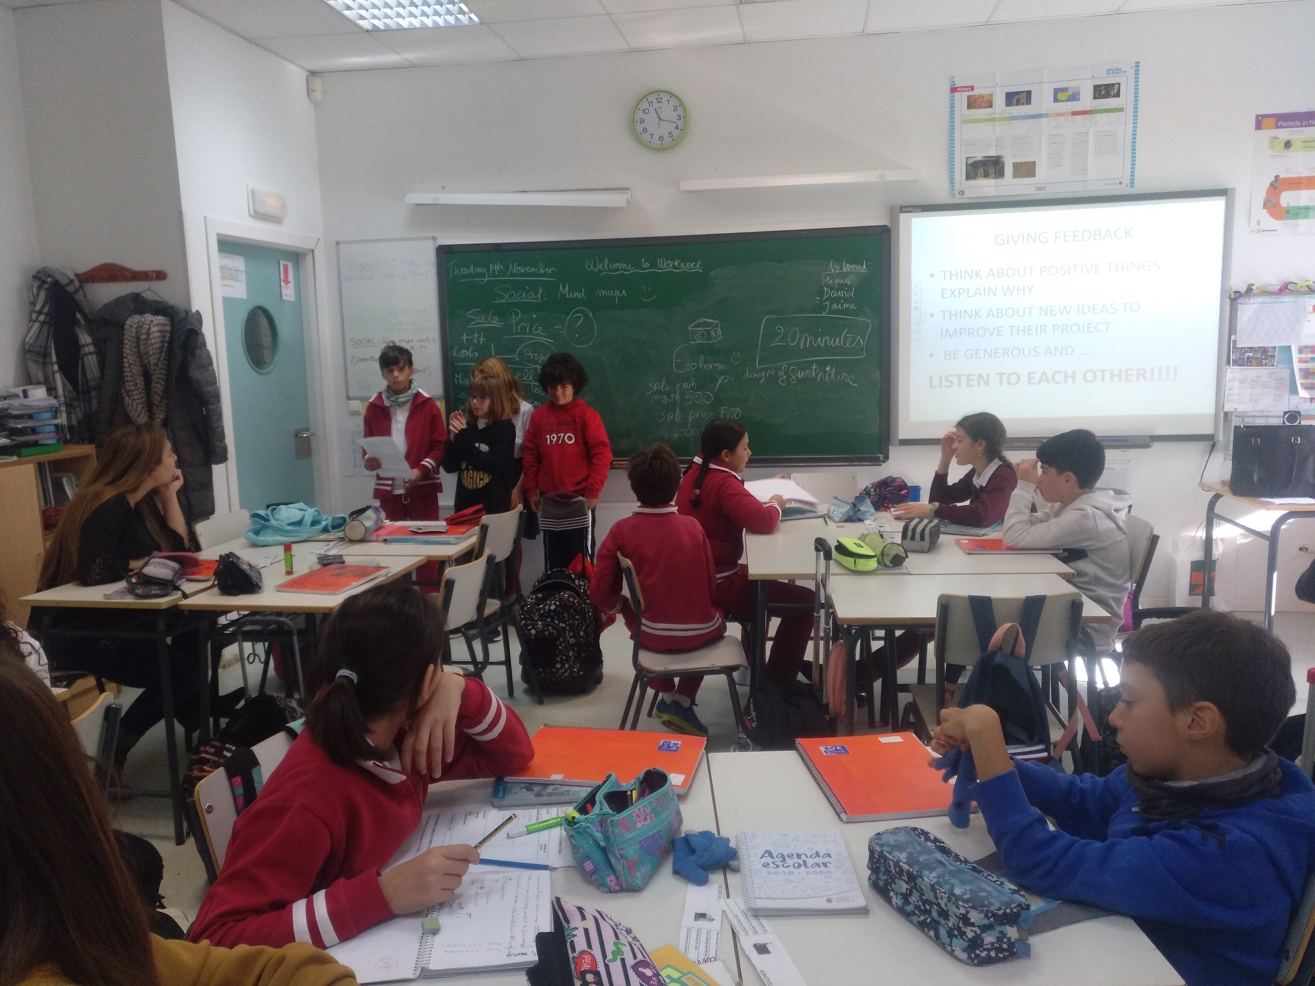
Empreneurship activity
Making a budget for your business
Making a shopping plan
Being a responsible consumer
Presenting the budget to the class

Slide 23
Empreneurship activity: professions

Slide 24
Collaborative games and SPORTS DAY

Slide 25
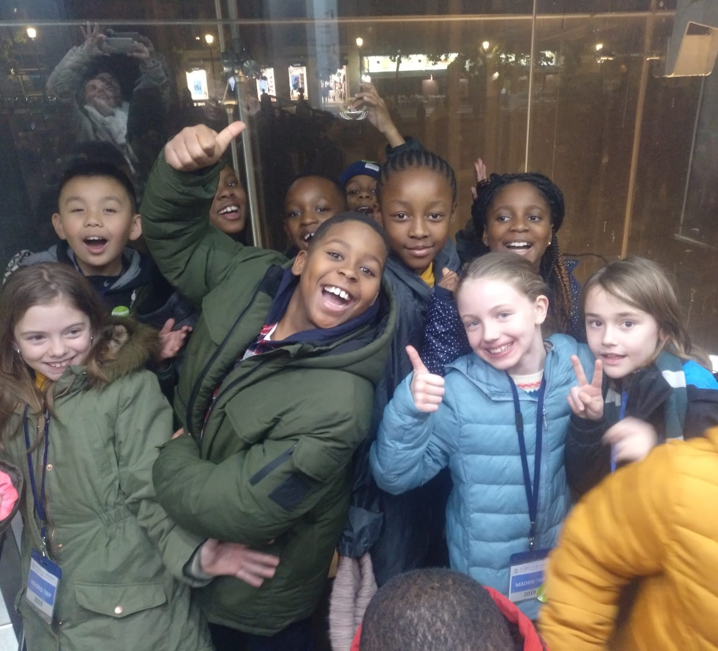
Visit to the Reina Sofía Museum-Madrid

Slide 26
Farewell and THANK YOU

