Slide 1
Calculation
Year 5
Solve Problems involving
multiplication and division
(5C8a)

Slide 2
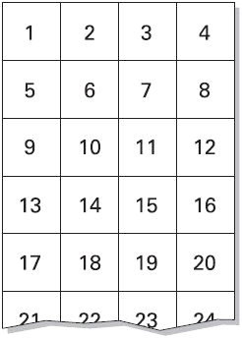
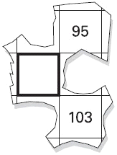
Generalising B3
Here is part of a number grid
Here is another part of the same grid.
Write in the missing number.
Notes:
Discussion ideas :
What is the pattern in each column? (increasing by 4 each time)
What is special about the last column? (this starts with 4 and increases by 4 so is the 4 times table/ multiples of 4)
What number would be below the 95? (95+4=99) Does the answer seem correct with the 103? (yes, 99+4=103)
What number would be in the bold square? (99-1 =98)
In which column would the numbers 27, 36, 42 be? How can you tell? (27: in first or third as it’s odd, in third because 28 is divisible by 4; 36: in the final column as it’s divisible by 4; 42:2nd or last column as it’s even but can’t be in last column as it isn’t divisible by 4)
What sized grid are we used to seeing and how do we use this (10 by 10)
Answer :
Chart completed as shown: 1 mark

Slide 3
Generalising B4
The numbers in this sequence increase by the same amount each time
Write in the missing numbers
Notes:
Discussion ideas:
How many steps are there between 1 and 13? (3 steps, not 2)
What are those three steps worth? (13-1 = 12)
What is each step worth? (12÷3 = 4)
What are the missing numbers?
Some children may prefer to use trial and improvement – i.e. try numbers out to see if they fit. This method may be a good starting point for some children, but try to encourage them to use the more mathematical reasoning outlined in the bullets above
What if the last number was changed to 16? (steps would be worth 5)
What if the first number was 5 and the last number was 38? (steps would be worth 11)
Answer:
1 mark
Further ideas:
Encourage children to create their own problems for each other, extending to negative numbers and/or more gaps, e.g.

Slide 4
Generalising B6
A sequence starts at 500 and 80 is subtracted each time.
500 420 340...
The sequence continues in the same way.
Write the first two numbers in the sequence which are less than zero.
Notes:
Discussion ideas:
About how many 80s are there between 0 and 340? (about 4)
What would be the smallest positive number in the sequence? (340 – 4x80=20)
What would be the next two numbers in the sequence? -60, -140
What if the first number was 510, would you have to recalculate or could you use the values you have to help? (use values and add on 10)
Ask children to create similar sequence challenges for a partner to solve
Answer:
–60 in first box. Up to 2 marks
Accept ‘minus 60’
Do not accept ‘60–’
–140 in second box
Accept ‘minus 140’
Do not accept ‘140–’

