Slide 1
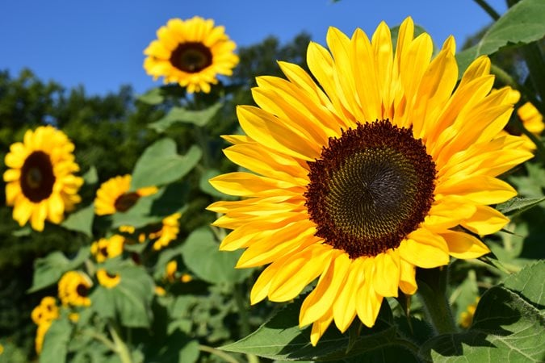
Year 1 and 2 Science Planning Summer 1
Plants

Slide 2
To find out what sort of trees and plants grow in the school grounds
I can name some of the trees in the school grounds
I can talk about the similarities and differences between different trees
To find out about the plants that grow in the local area
• I can think about where plants grow and how they get there
• I can investigate and discover plants in the local area
• I can record my results
(soanes centre – plant life)
STEM activity: Plant Detectives pages 38 - 41

Slide 3
Key Vocabulary
habitat
trees
leaves
plants
difference

Slide 4
Let’s be plant detectives! We are going to go and explore what sorts of trees and plants grow in our forest school area – and the area outside the front of our school.
We will take some photos and pick some leaves to observe the differences we see between the different plants and trees.
First let’s learn some of the names of common trees that we might find in the UK.

Slide 5
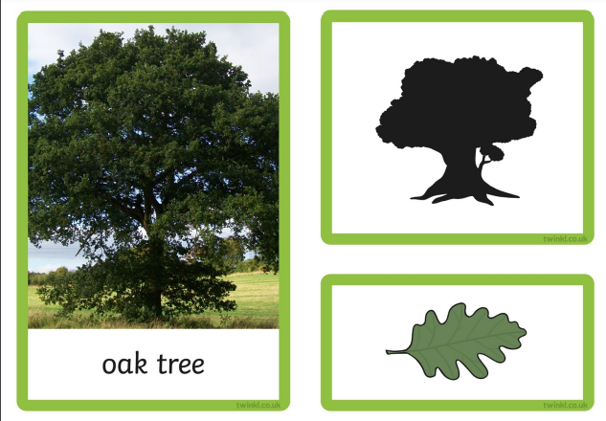
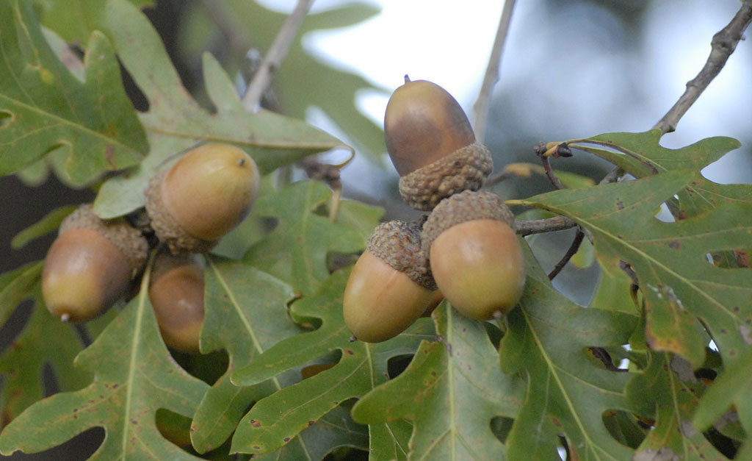
What do you see?
How can you describe the shape of the leaf?
acorns

Slide 6
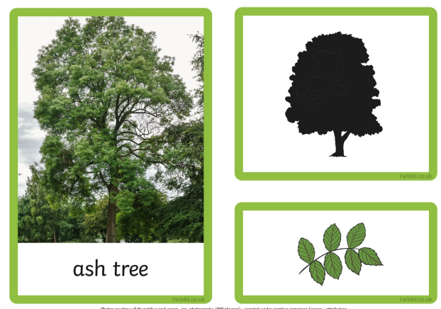

Slide 7
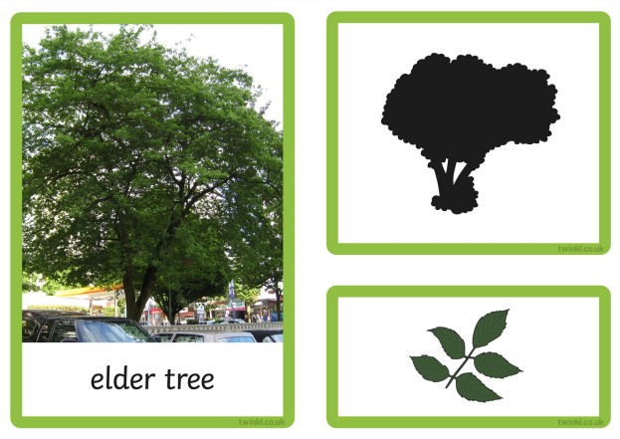
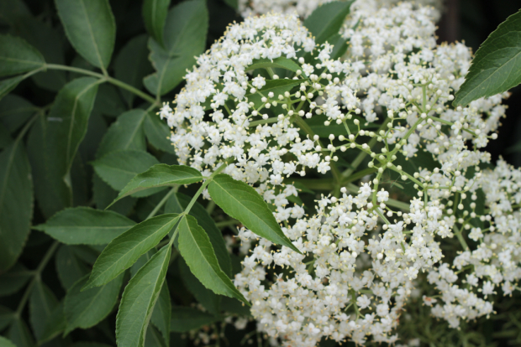

Slide 8
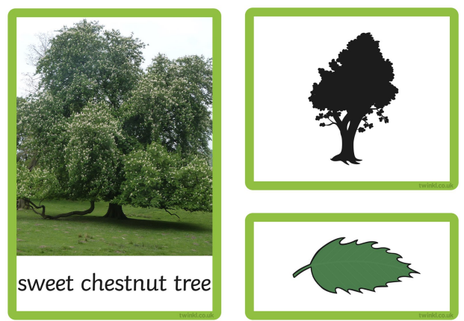
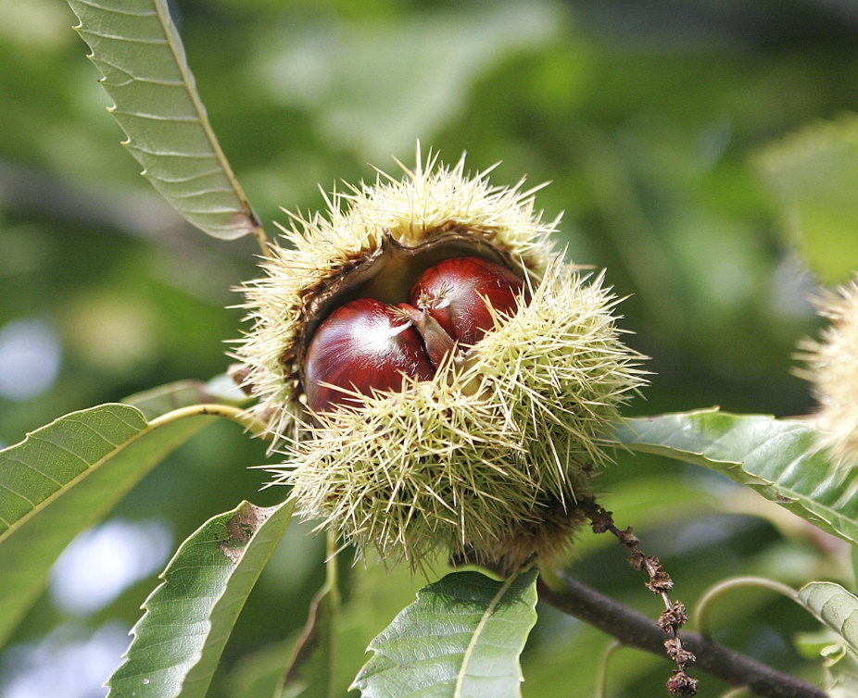
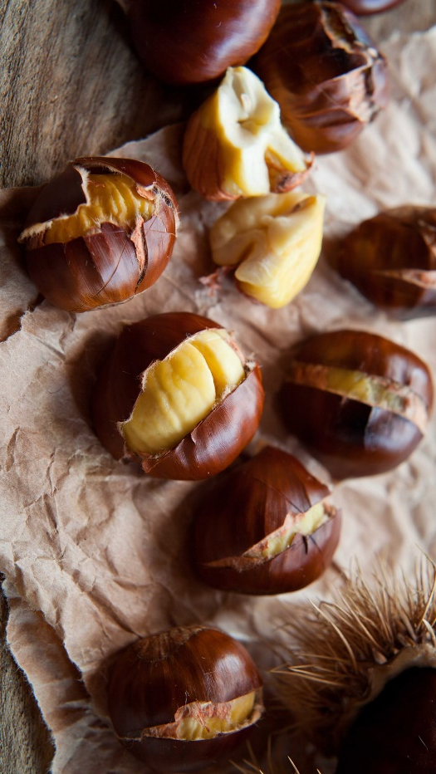
chestnuts

Slide 9
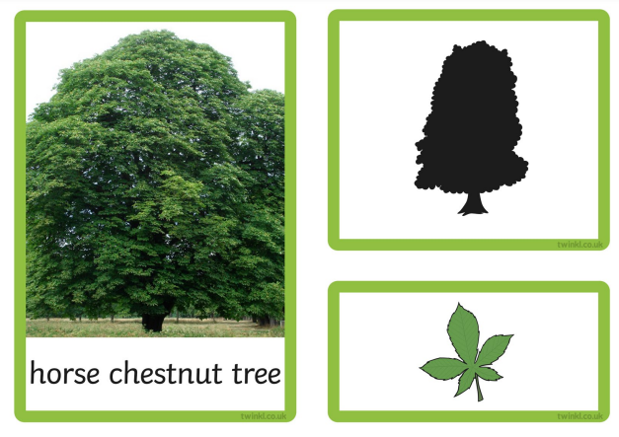
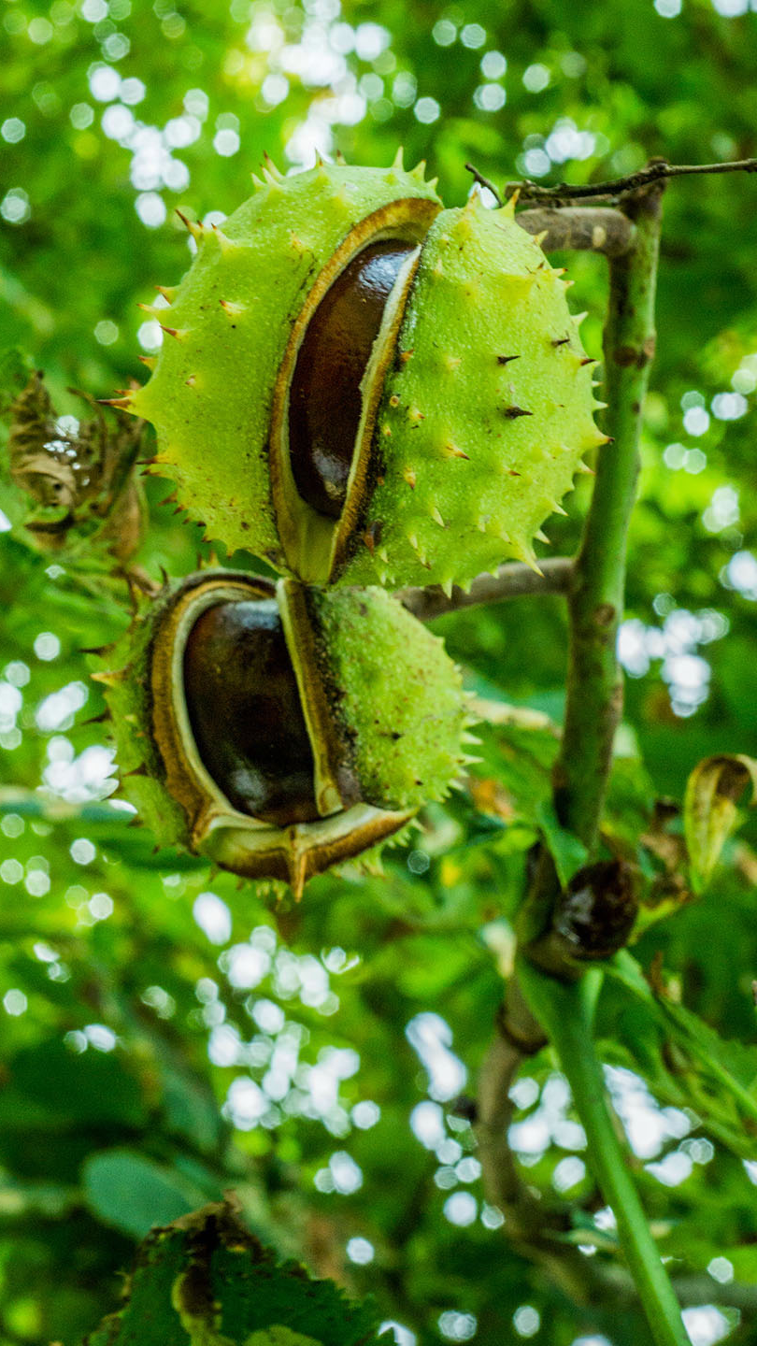
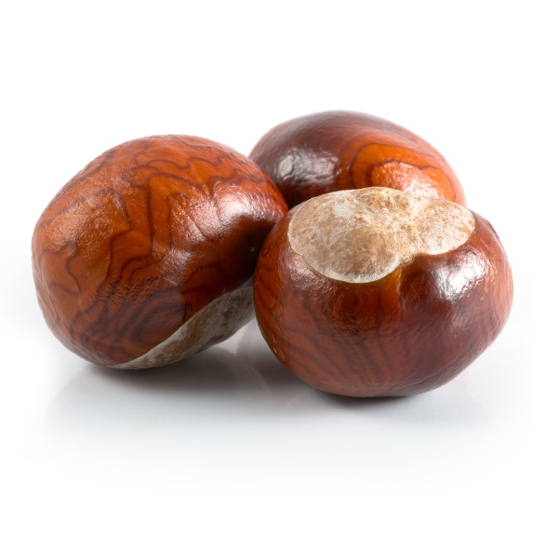
conkers

Slide 10
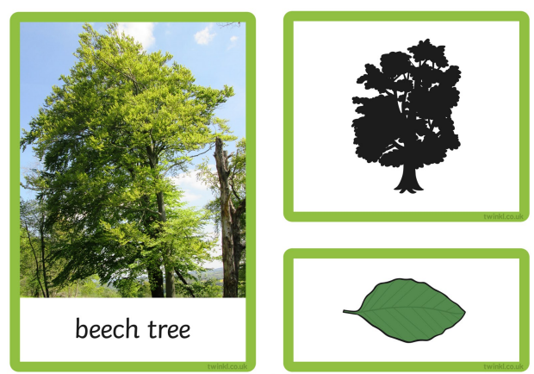

Slide 11
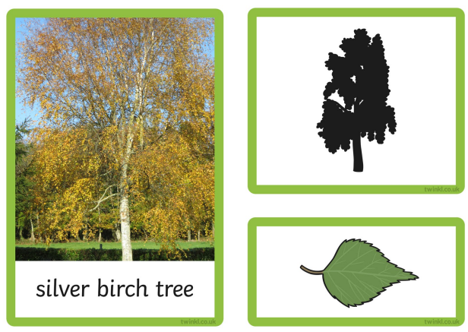
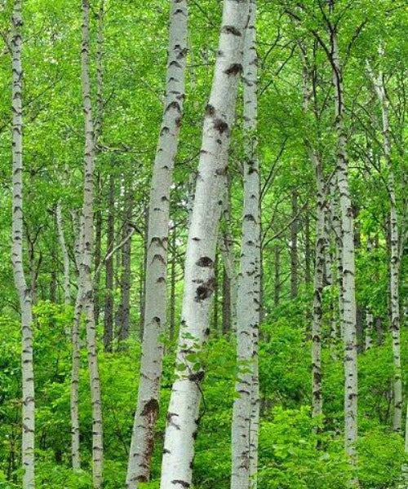

Slide 12
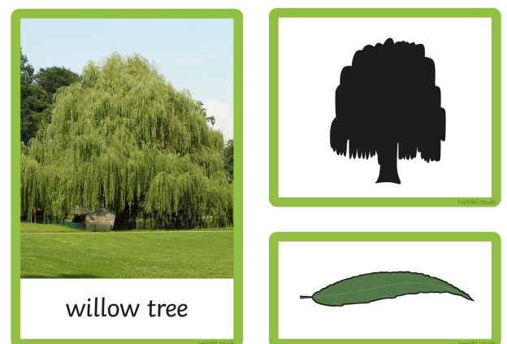

Slide 13
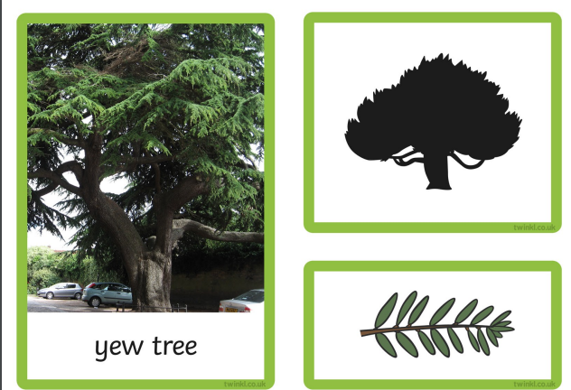

Slide 14
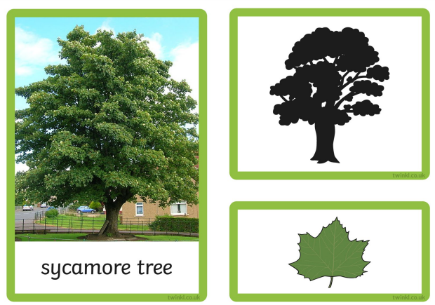
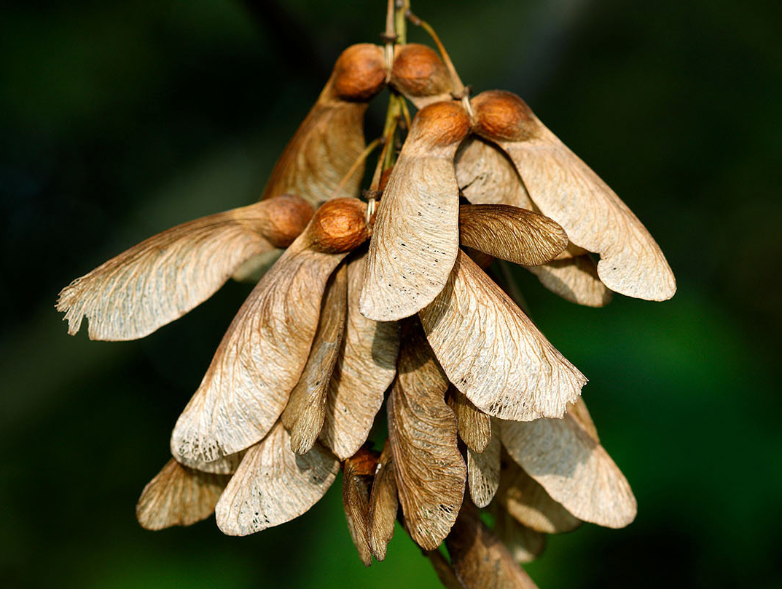

Slide 15
Independent activity:
Observe the leaves closely and draw pictures or take rubbings of the leaves.
Do any of the leaves look like the ones we have looked at?

Slide 16
To plant a bean and observe its growth over time.
• I can plant a bean
• I can write instructions to describe how to plant a bean
• I can describe what happens to the bean over time
To observe and describe how seeds and bulbs grow into mature plants.
I can follow instructions to plant a seed and a bulb
I can suggest how to care for a plant so it grows well
I can set up a simple test to show what plants need to grow well
I can predict which plants will grow well and which will not

Slide 17
Key Vocabulary
seeds
bulbs
soil
sunlight
water
germination
sprout
shoot

Slide 18
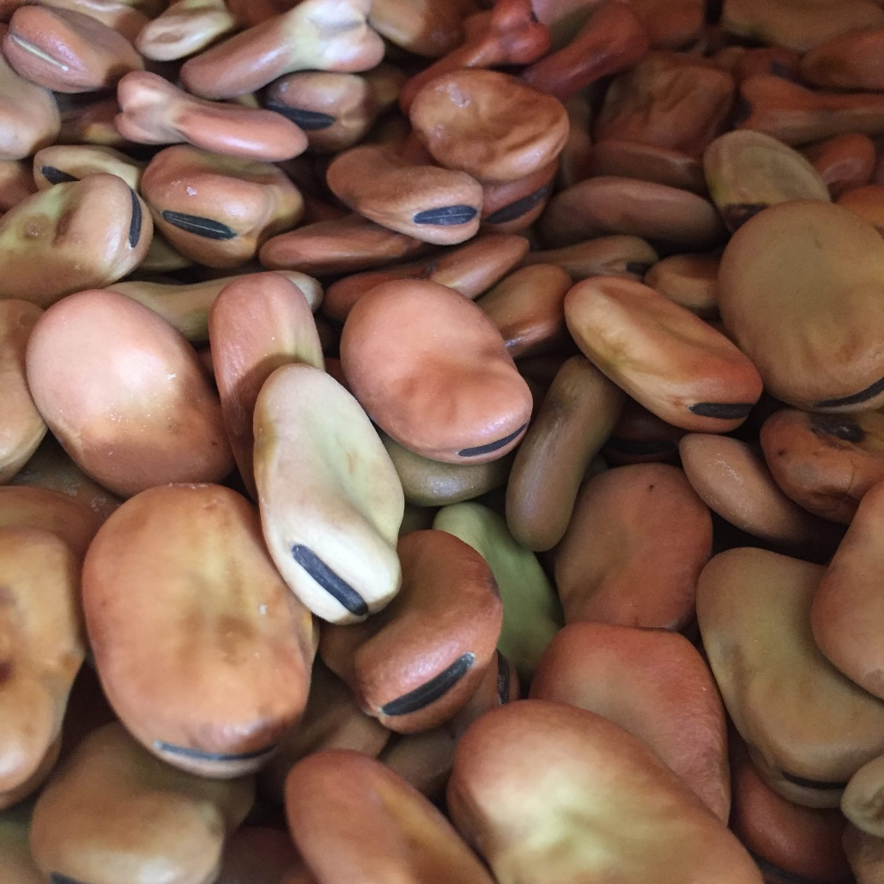
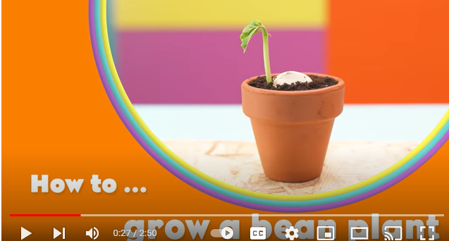
Let’s watch this video on how to plant a bean.
Bean seeds
What does the seed need to be able to grow well?

Slide 19
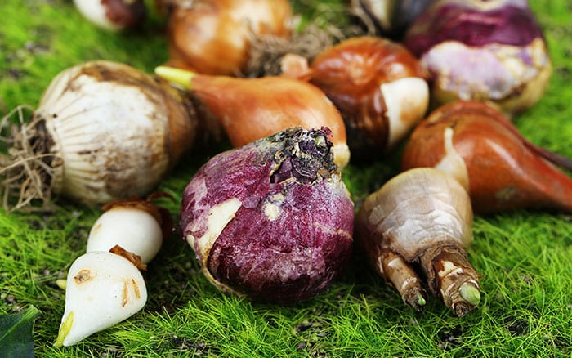
bulbs
We can also grow something called bulbs.
Bulbs can stay in the ground and produce new flowers every year, unlike a bean plant which will die once the autumn comes.
Do you know what sorts of flowers grow from bulbs?
Let’s look at some examples on the next slide….

Slide 20
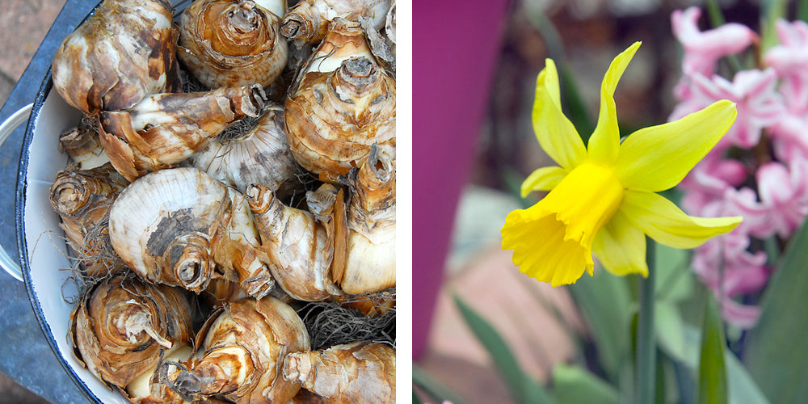
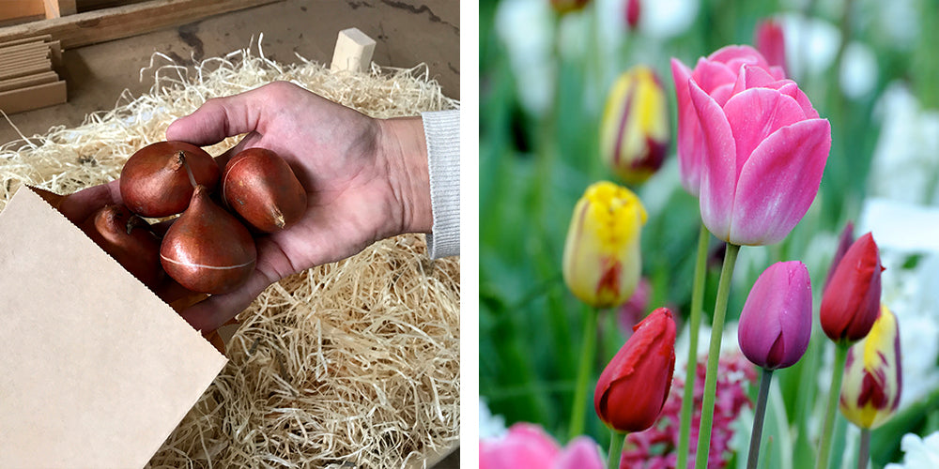
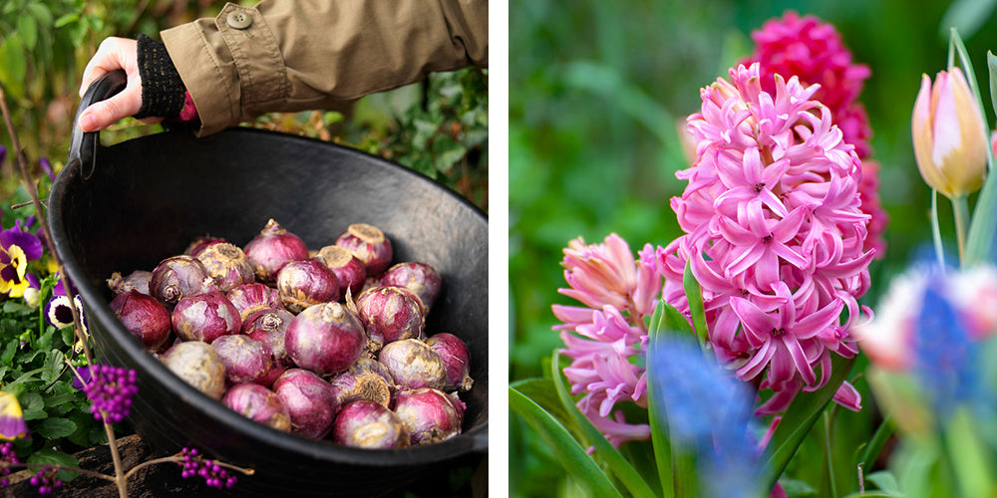
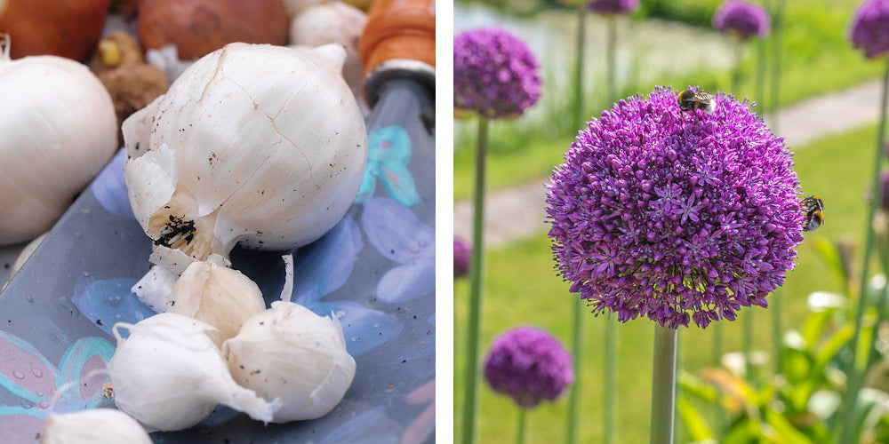
daffodils
tulips
hyacinths
alliums (onions)

Slide 21
What do you think will happen if a seed or bulb does not have everything it needs to grow well?
Year 2 will be investigating what might happen.
How can we set up a test to investigate this when we plant our bulbs and seeds?

Slide 22
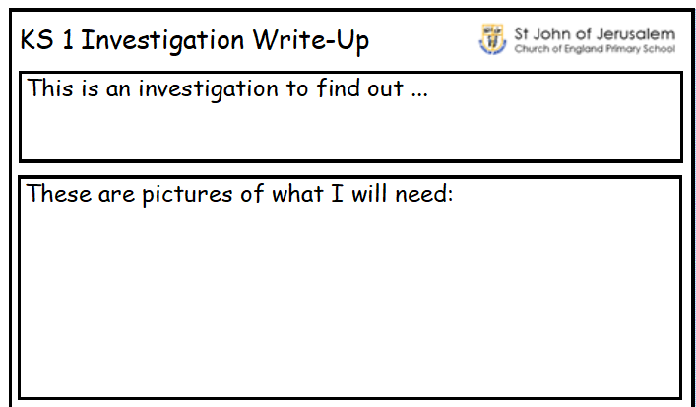
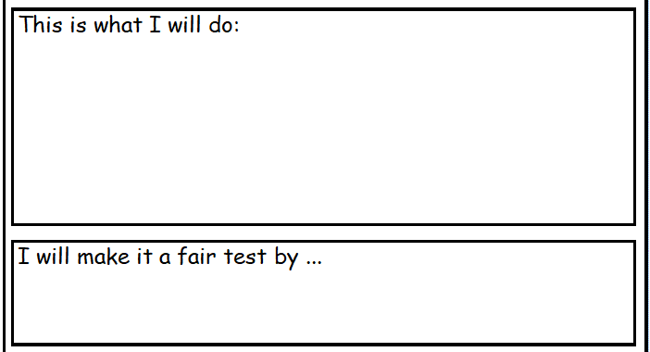
Independent activity
Y1 will plant their seeds and write instructions to show how to plant a seed.
Y2 will think how to do their investigation and complete the investigation sheet.
Then they will plant the seeds/bulbs.

Slide 23
To understand and explain what plants need to be able to grow well.
• I can say five things that plants need to grow
• I can say what might happen if they do not have what they need.
To understand the life cycle of plants.
I can describe stages in the life cycle of a plant
I can order the life cycle of a plant
I can explain that plants are living things
I can explain something plants do that shows us that plants are living things

Slide 24
Key Vocabulary
soil
sunlight
water
lifecycle
MRS GREN

Slide 25
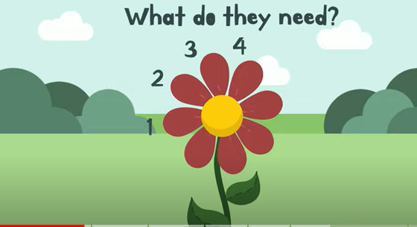
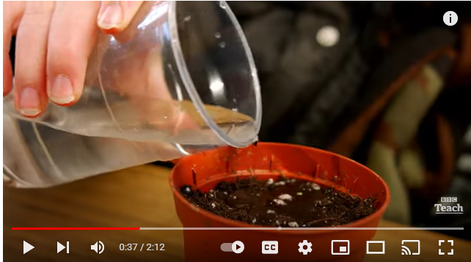
What do seeds need to be able to grow well?
The lifecycle of a plant
You might like to read…

Slide 26
Independent activity
Next step:
What might happen if a plant did not have water?
Y1 will create a little book to show the 5 things a plant needs to grow well.
Y2 will create a labelled diagram to show the lifecycle of a plant.
Next step:
Can you explain how a plant shows any of the life processes?
MRS GREN

Slide 27
To identify and describe the parts of plants and trees.
• I can label the parts of a plant
• I can say the names of parts of trees
To find out and describe how plants need water, light and a suitable temperature to grow and stay healthy.
• I can explain what plants need to grow well
• I can give reasons for my answers
• I can record the growth of plants by drawing or writing

Slide 28
Key Vocabulary
roots
stem
flowers
petals
leaves
soil
sunlight
water
temperature
nutrition
lifecycle

Slide 29
Independent activity
Y1 will draw diagrams or stick pictures to show the parts or plants and trees.
Next step:
Do you remember the names of any of the trees we have learnt about?
Y2 will observe the growth of their seeds and bulbs, including the ones that did not have everything needed to grow well.
Record what has happened so far.
Next step:

Slide 30
To identify and name some garden plants.
I can name some of the garden plants that I see in the school grounds
I can describe some of the features of these plants
To find out and explain how plants are suited to their habitats
I can say how plants have different features that make them suited to where they live
I can identify plants that live in hot, dry, cold or wet places
I can explain how I know which type of habitat each plant grows in

Slide 31
Key Vocabulary
habitat
adapt
suited

Slide 32
To record their observations of how their bean grew.
• I can describe how my bean plant has changed
• I can measure my bean plant with a ruler
To observe how different types of plants grow.
• I can record how my plants have grown
• I can compare the growth of my plants
• I can measure the growth of my plants with a ruler
• I can record the growth of my plants in a bar chart

Slide 33
Key Vocabulary

